Slide 1
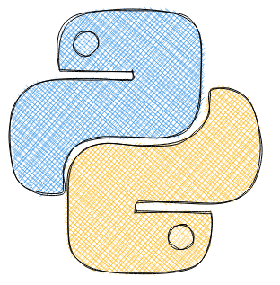
Data Science terminology diversity
Week1
Data Science terminology overview and Introduction to Python (Part I)
Middlesex University Dubai: Winter22
CST4050; Instructor: Dr. Ivan Reznikov

Slide 2
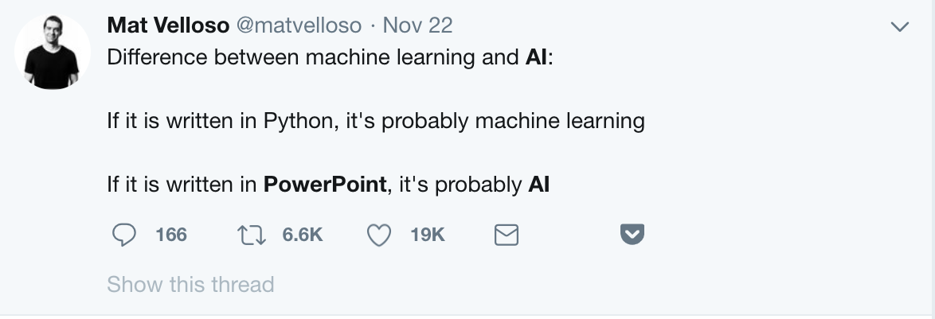
Machine Learning vs AI
Jokes aside, nowadays, it’s sometimes quite hard to distinguish Machine Leaning terminology
1

Slide 3

Data Science vs All: Terminology
FUTURE
Analytics
Analysis
PAST
in theory
Data Analysis ≠ Data Analytics
Business Analysis ≠ Business Analytics
… Analysis ≠ … Analytics
1

Slide 4

Data Science vs All: Terminology
FUTURE
Analytics
Analysis
PAST
on practice
Data Analysis ≠ Data Analytics
Business Analysis ≠ Business Analytics
… Analysis ≠ … Analytics
1

Slide 5

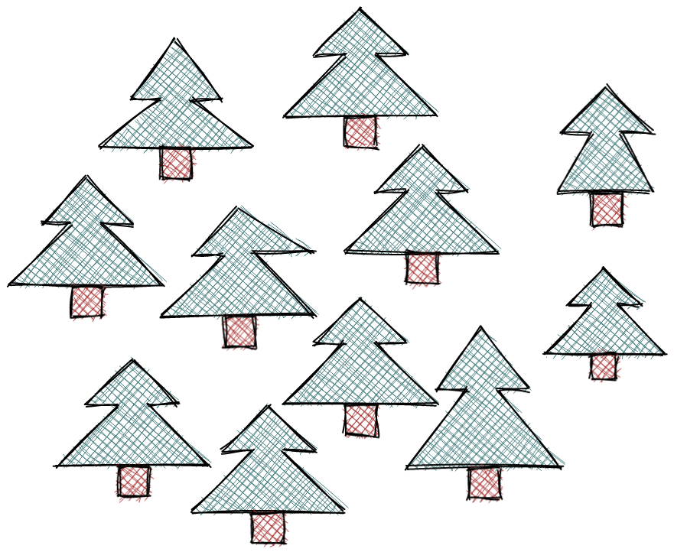
Data Science vs All: Terminology
Qualitative
Quantitative
Trees are green
Different heights
Pine needles smell
Most forests are located in Europe
10 trees
6 trees are same
Trees height range from X to Y m.
Forest takes around 38% of habitable land
We will operate with Q|Q terminology in the future slides
1

Slide 6
Data Science vs All: Terminology
The next couple of slides will be dedicated to understanding the overlapping of the following terms:
Business Analytics
Data Analytics
Data Science
Data Engineering
Machine Learning
Business Intelligence
Artificial Intelligence
Some may have seen other representations – probably because nowadays, there is no absolute truth on what each term means, as the field is rapidly changing.

Slide 7




Data Science vs All
* Case Study – you analyze cases of companies in the past
** Quantitative Analytics – expert believe that ….. will increase …..
*** Preliminary Data Report – rough numbers by prior research
Business Analytics
Business Analytics
Data Analytics
Data Science
Data Engineering
Machine Learning
Business Intelligence
Artificial Intelligence
Business Analytics
*
**
***
Business Intelligence
Data
Analytics
Data
Engineering
Data
Science
Machine
Learning
Artificial
Intelligence
Past
Future

Slide 8

Data Science vs All
* Signal Processing,
Fourier Transform
Business Analytics
Data Analytics
Data Science
Data Engineering
Machine Learning
Business Intelligence
Artificial Intelligence
Business Analytics
Business Intelligence
*
Data
Analytics
Data
Engineering
Data
Science
Machine
Learning
Artificial
Intelligence
Past
Future

Slide 9

Data Science vs All
* Dashboards and Reporting Visuals
** Sales Forecasting via Statistics, Linear Regression
*** Fraud Prevention
Business Analytics
Data Analytics
Data Science
Data Engineering
Machine Learning
Business Intelligence
Artificial Intelligence
Business Analytics
Business Intelligence
Data
Analytics
Data
Engineering
Data
Science
*
**
Machine
Learning
Artificial
Intelligence
***
Past
Future

Slide 10

Data Science vs All
* Data Systematization
Business Analytics
Data Analytics
Data Science
Data Engineering
Machine Learning
Business Intelligence
Artificial Intelligence
Business Analytics
Business Intelligence
Data
Analytics
Data
Engineering
*
Data
Science
Machine
Learning
Artificial
Intelligence
Past
Future

Slide 11

Data Science vs All
Business Analytics
Data Analytics
Data Science
Data Engineering
Machine Learning
Business Intelligence
Artificial Intelligence
Business Analytics
Business Intelligence
Data
Analytics
Data
Engineering
Data
Science
Machine
Learning
Artificial
Intelligence
Past
Future

Slide 12

Data Science vs All
* Reporting
** Real-time dashboards
Business Analytics
Data Analytics
Data Science
Data Engineering
Machine Learning
Business Intelligence
Artificial Intelligence
Business Analytics
Business Intelligence
Data
Analytics
*
Data
Engineering
**
Data
Science
**
Machine
Learning
Artificial
Intelligence
Past
Future

Slide 13
Data Science vs All
* Knowledge modelling, symbolic reasoning
Business Analytics
Data Analytics
Data Science
Data Engineering
Machine Learning
Business Intelligence
Artificial Intelligence
Business Analytics
Business Intelligence
Data
Analytics
Data
Engineering
Data
Science
Machine
Learning
Artificial
Intelligence
*
Past
Future

Slide 14
Data Science vs All
Sweet spot
Business Analytics
Data Analytics
Data Science
Data Engineering
Machine Learning
Business Intelligence
Artificial Intelligence
Business Analytics
Business Intelligence
Data
Analytics
Data
Engineering
Data
Science
Machine
Learning
Artificial
Intelligence
Past
Future

